Slide 1

Transition to Transport (TCP)
CSE 118: Computer Networks
George Varghese
(based on slides by Alex Snoeren)
You’ve already implemented much of this in Project 2 but now we study the why and what else?

Slide 2
Project 2 Questions
Do you feel this kind of coding skill is not used in industry?
What was the hardest part?
How many of you have done some similar coding in C as part of the OS class in a hard to debug environment
What could we do different?
What could you have done differently?
Why do you think we changed the grading rubric at the end. What would have been a fairer way?

Slide 3
Project 2
Generous partial credit which we will discuss in discussions
This Friday we will do a discussion on reviewing a good solution for Project 1 to see what you might learn that is useful for Project 2
Start early. It takes 4 weeks even if its 200-500 lines of codes

Slide 4
THE IP ABSTRACTIONS: Each layer provides a service to the layer above it
Copy File F at S
to File F at D
S
R1
R2
D
User Interface
Write (m) to connection queue
Read (m)
Transport (TCP)
Interface
^{F}6-8 | ^{F}2-5 | F₁
Send (segment) to D
Receive (segment)
Routing (IP) Interface
S
R1
R2
D
other paths?
Send (packet)
Receive (packet)
Data Link Interface
R1
R2
Send (bit)
Receive (bit)
Physical Layer Interface

Slide 5
Recall Big Picture
Router
Ethernet
FDDI
data packet
data packet
Eth
IP
TCP
HTTP
FDDI
IP
TCP
HTTP

Slide 6
Overview
Process naming/demultiplexing
User Datagram Protocol (UDP)
Transport Control Protocol (TCP)
Three-way handshake
Reliability and retranmission

Slide 7
Where Transport Layer Fits
host
host
Application Layer
HTTP
HTTP
Transport Layer
TCP
TCP
router
router
Network Layer
IP
IP
IP
IP
Link Layer
Ethernet
interface
Ethernet
interface
SONET
interface
SONET
interface
Ethernet
interface
Ethernet
interface

Slide 8
Basic Transport Questions
BASIC QUESTIONS
What function does a transport provide?
What is a connection?
Why not have just one connection for all data?
Why not keep connections up always?
How do we address the receiving process in the receiver machine?
P3
P1
P2
P4
P1,..P4 denote processes (mail, ftp)
−−− lines denote connections

Slide 9
Basic Transport Answers
ANSWERS
Reliable or Unreliable data Delivery between processes
Shared state for each process pair that enables delivery
Fast processes would be hostage to slow processes
Too many possible process pairs→ close + set up connections
Need an OS independent mechanism: ports
P3
P1
P2
P4
P1,..P4 denote processes (mail, ftp)
−−− lines denote connections

Slide 10
Transport Layer Tasks
Multiplexing (UDP does only this, so does TCP)
Reliability (TCP only)
Flow Control (TCP only)
Congestion Control (TCP only)

Slide 11
Naming Processes/Services
Process here is an abstract term for your Web browser (HTTP), Email servers (SMTP), hostname translation (DNS)
How do we identify for remote communication?
Process id or memory address are OS-specific and transient
So TCP and UDP use ports
16-bit integers representing mailboxes that processes “rent”
Identify process uniquely as (IP address, protocol, port)

Slide 12
Picking Port Numbers
We still have the problem of allocating port numbers
What port should a Web server use on host X?
To what port should you send to contact that Web server?
Servers typically bind to well-known port numbers
e.g., HTTP 80, SMTP 25, DNS 53, … look in /etc/services
Ports below 1024 traditionally reserved for well-known services
Clients use OS-assigned temporary (ephemeral) ports
Above 1024, recycled by OS when client finished

Slide 13
User Datagram Protocol (UDP)
Provides unreliable message delivery between processes. So what does it do? Multiplexing!
Source port filled in by OS as message is sent
Destination port identifies UDP delivery queue at endpoint
Connectionless (no state about who talks to whom)
0
16
31
SrcPort
DstPort
Checksum
Length
Data

Slide 14
UDP Delivery
Application
Application
Application
process
process
process
Kernel
boundary
Ports
Message
Queues
DeMux
Packets arrive

Slide 15
UDP Checksum
UDP includes optional protection against errors
Checksum intended as an end-to-end check on delivery
So it covers data, UDP header, and IP pseudoheader
0
16
31
SrcPort
DstPort
Checksum
Length
Data

Slide 16
Applications for UDP
Streaming media (e.g., live video)
DNS (Domain Name Service)
NTP (Network Time Protocol) (synchronizing clocks)
FPS multi-player video games (e.g., Call of Duty)
Why might UDP be appropriate for these?

Slide 17
Transmission Control Protocol
Reliable bi-directional bytestream between processes
Uses a sliding window protocol for efficient transfer
Connection-oriented
Conversation between two endpoints with beginning and end
Flow control (generalization of sliding window)
Prevents sender from over-running receiver buffers
(tell sender how much buffer is left at receiver)
Congestion control (next lecture)
Prevents sender from over-running network capacity

Slide 18
TCP Delivery
Application process
Application process
W
rite
Read
…
bytes
…
bytes
TCP
TCP
Send buffer
Receive buffer
Transmit segments
Segment
Segment
…
Segment

Slide 19
TCP like reliable data link
Remember we said that when we did reliable data links that TCP would be similar (but end-to-end)
This is where we “cash in” for all the hard work we did in sliding windows, go back N, Restart Protocols etc
As a first approximation, TCP takes the bytes the user writes to the queue, packages them in segments, adds a sequence number and does Go Back N
But there are differences we need to understand

Slide 20
Differences between Data Link reliability and TCP – Part 1
We”ll do this second
We”ll do this first

Slide 21
Differences between Data Link reliability and TCP – Part 2
We”ll do these next lecture

Slide 22
Project 2 versus “real” TCP
Project 2 similar to TCP
Similar 3-way handshake using SYN, SYN-ACK
Large sequence number to handle out of order
Retransmission of lost packets, even 3 DUP ACK rule!
Project 2 different from TCP
Retransmission timer fixed but TCP computes it dynamically
Window fixed but TCP computes it dynamically (flow and congestion control, next lecture)
Sophisticated upgrades like Selected Reject (TCP SACK) not in Project 2 which is basically GO BACK N

Slide 23
Part 1:Connection Set up
Both sender and receiver must be ready before we start to transfer the data
Sender and receiver need to agree on a set of parameters
Most important: sequence number space in each direction
Lots of other parameters: e.g., the Maximum Segment Size
Handshake protocols: setup state between two oblivious endpoints
Need to deal with delayed and reordered packets
Lets illustrate the problem with the sad tale of John and Martha

Slide 24
Going to the Cafe Protocol
JOHN
MARTHA
Hi
Hi
Lets meet at the cafe
OK
Bye
Goes to cafe
Bye
Goes to cafe

Slide 25
Misery caused by duplicates
JOHN
(at beach)
MARTHA
old duplicates
Hi
Hi
Lets meet at the cafe
OK
Bye
Goes to cafe
Bye

Slide 26
One way out: lots of state
JOHN
(at beach)
MARTHA
old duplicates
Hi, 13
Last heard 15 from John
Lets meet at the cafe, 14
Discard as duplicates
Bye, 15
Martha has to remember last number from John for worst−case packet lifetime. Called Timer−based connection management.

Slide 27
TCP’s way: 3-way handshake
JOHN
Choose x
MARTHA
Hi,x
Choose y
Hi,x,y
Lets meet at the cafe,x,y
OK,x,y Bye,x,y
Goes to cafe
Bye,x,y
Goes to cafe
(x is validation number unused before by x)

Slide 28
Why nonces/random numbers defend against delayed duplicates
JOHN
(at beach)
MARTHA
Hi, x
Choose unused y
Hi, x, y
Lets meet at the cafe, x, z
Reject

Slide 29
Connection Names: 4-tuples
Gmail client
Connection C1
1290
128.55.1.2, 1290, 130.1.1, 25, TCP
25
TCP
TCP
Gmail
1511
25
FB client
Laptop 1
128.55.1.2
Internet
Gmail Server
130.1.1.1
Gmail client
TCP
TCP
80
FB
14511
Workstation
130.55.1.3
Facebook Server
140.1.1.1

Slide 30
Three-Way Handshake in TCP
Opens both directions for transfer
Active participant
Passive participant
(client)
(server)
SYN, SequenceNum =
x
y
,
SYN + ACK, SequenceNum =
+
1
x
Acknowledgment =
ACK, Acknowledgment =
y
+
1
+data

Slide 31
TCP Header Format
Flags may be ACK, SYN, FIN, URG, PSH, RST
0
4
10
16
31
SrcPort
DstPort
SequenceNum
Acknowledgment
HdrLen
0
Flags
AdvertisedWindow
Checksum
UrgPtr
Options (variable)
Data

Slide 32
TCP Header Format
Ports plus IP addresses identify a connection (4-tuple)
0
4
10
16
31
SrcPort
DstPort
SequenceNum
Acknowledgment
HdrLen
0
Flags
AdvertisedWindow
Checksum
UrgPtr
Options (variable)
Data

Slide 33
3-way handshake details
We could abbreviate this setup, but it was chosen to be robust, especially against delayed duplicates
Three-way handshake first described inTomlinson 1975
Choice of changing initial sequence numbers (ISNs) minimizes the chance of hosts that crash getting confused by a previous incarnation of a connection
How to choose ISNs?
Maximize period between reuse
Minimize ability to guess (why?)
Random works OK, as in Project 2

Slide 34
3-way handshake in TCP
Server: If in LISTEN and SYN arrives, then transition to SYN_RCVD state, replying with ACK+SYN.
Client: active open, send SYN segment and transition to SYN_SENT.
Arrival of SYN+ACK causes the client to move to ESTABLISHED and send an ack
When this ACK arrives the server finally moves to the ESTABLISHED state.

Slide 35
So now how do we disconnect
Need timers anyway to get rid of connection state to dead nodes.
However, timer should be large so that "keepalive" hello overhead is low.
If communication is working, would prefer graceful closing (so receiver process knows quickly) to long timers.
Hence 3 phase disconnect handshake After sending disconnect and
receiving disconnect ack, both sender and receiver set short timers.

Slide 36
TCP Connection Teardown
Web server
Web browser
FIN_WAIT_1
FIN
Active close
Passive close
CLOSE_WAIT
ACK
LAST_ACK
FIN_WAIT_2
FIN
TIME_WAIT
ACK
…
CLOSED
CLOSED

Slide 37
The TIME_WAIT State
We wait 2*MSL (maximum segment lifetime of 60 seconds) before completing the close
Why?
ACK might have been lost and so FIN will be resent
Could interfere with a subsequent connection
Real life: Abortive close
Don’t wait for 2*MSL, simply send Reset packet (RST)

Slide 38
Part 2: Reliable delivery
Usual sequence numbers except:
Very large to deal with out of order (modulus > 2 W etc. only works on FIFO links). As in Project 2
TCP numbers bytes not segments: allows it to change packet size in the middle of a connection
The sequence numbers don’t start with 0 but with an ISN.
Reliable Mechanisms similar except:
TCP has a quicker way to react to lost messages
TCP does a crude form of selective reject not go-back N
TCP does flow control by allowing a dynamic window which receiver can set to reduce traffic rate (next lecture)

Slide 39
Remember Go-Back-N
Sender
Receiver
Sender
Receiver
Retransmit all packets from point of loss
Packets sent after loss event are ignored (i.e., sent again)
Simple to implement (receiver very simple)
Sender controls how much data is “in flight”
Data 0
Data 0
Data 1
Data 1
Data 2
ACK 0
Data 2
ACK 0
Data 3
Data 3
ACK 1
ACK 1
timeout
ACK 2
ACK 1
ACK 3
Data 2
Data 4

Slide 40
TCP Header Format
Sequence, Ack numbers used for the sliding window
How big a window? Flow control/congestion control determine
0
4
10
16
31
SrcPort
DstPort
SequenceNum
Acknowledgment
HdrLen
0
Flags
AdvertisedWindow
Checksum
UrgPtr
Options (variable)
Data

Slide 41
Deciding When to Retransmit
How do you know when a packet has been lost?
Ultimately sender uses timers to decide when to retransmit
But how long should the timer be?
Too long: inefficient (large delays, poor use of bandwidth)
Too short: may retransmit unnecessarily (causing extra traffic)
Right timer is based on the round-trip time (RTT)
Which can vary greatly so we need to measure (next lecture)
But OS timer granularity makes it large (msec)
So we need another trick for common case error recovery

Slide 42
TCP Trick: Fast retransmit
Don’t bother waiting
Receipt of duplicate acknowledgement (dupACK) indicates loss
Retransmit immediately
Used in TCP
Need to be careful if frames can be reordered
Today’s TCP identifies a loss if there are three duplicate ACKs in a row. Project 2 did this!
Sender
Receiver
Data 0
Data 1
Data 2
ACK 0
ACK 1
Data 3
Data 4
ACK 1
Data 2

Slide 43
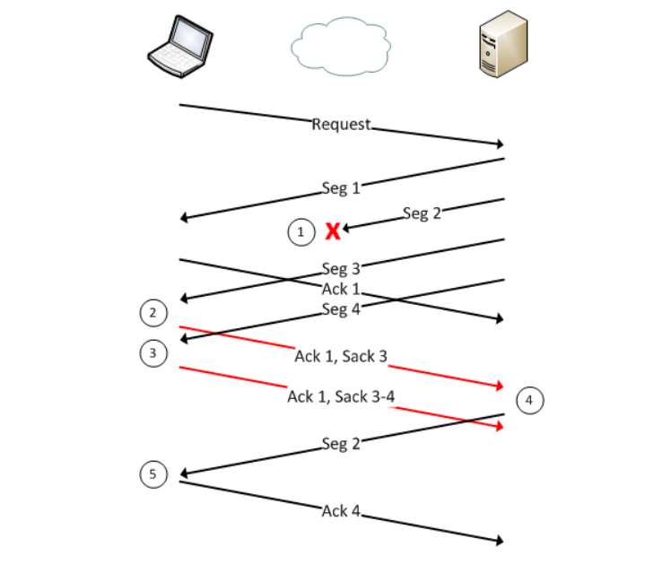
Now playing: TCP SACK
Has some limitations: like 3 SACK blocks

Slide 44
Socket Interface
P1
P2
P2
P1 Transport
Transport
socket
socket
sockfd
bind listen
bind
connect P2
accept
send
rcv

Slide 45
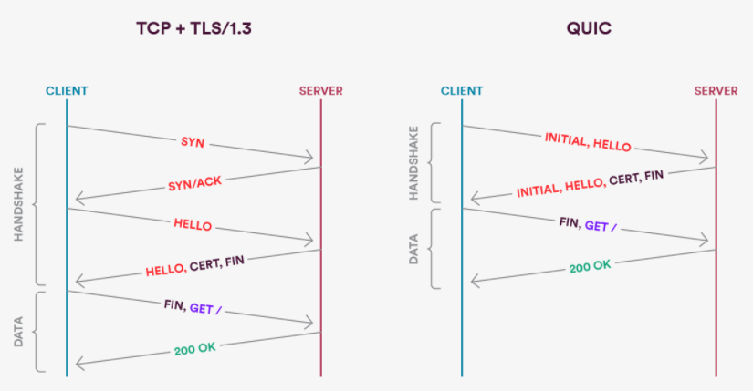
QUIK first connection to server

Slide 46
QUIC: what’s the latency trick
Idea 1: Combine security handshake and sequence number handshake on first connection to server
Idea 2: If server remembers information about client, need 0 handshakes on later connections
Three way handshakes are required because server forgets info on client. Important in old days but no longer as severs have massive memory
A round trip is a big deal (several hundred msec across US) at today’s high speeds

Slide 47
QUIC: what else is new
Stream multiplexing: multiple streams in a single QUIC connection between client and server for HTTP/2
No head of line blocking: can do HTTP/2 over a single TCP connection but a single loss stalls all streams. Not so in QUIC
Shared congestion information: as we will see it takes TCP a long time to ramp up. In QUIC all congestion information is shared.
Wave of future: 9% of all websites use QUIC (4/2023). 40% of Chrome traffic uses QUIC 2

